Slide 1
Information Security
Basic Security Concepts

Slide 2
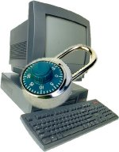
Brief History
In 1983, Kevin Mitnick did an intrusion on a Pentagon’s computer
Robert Tappan Morris created the first worm and sent it from MIT to the web and caused $50,000 worth of damages
In 1994, Vladimir Levin intruded in an American bank computer and stole 10 millions dollars
Jonathan James “c0mrade”, 16 years old, infiltrated a NASA computer in 1999 and had access to data worth 1,7 millions dollars
In recent times (CSI Report, 2007):
  46% of companies have admitted to suffering financial losses due to security incidences. The reported loss amounted to a total of approximately $66,930,000.
  39% of companies have been unable (or unwilling) to estimate the cost of their losses.
Financial Losses, Personal losses, Privacy losses, Data
Losses, Computer Malfunction and more…..

Slide 3

Computer Security
Computer and Network security was not at all well known, even about 20 years ago
Today, it is something everyone is aware of the need, but not sure what it really means
Interesting topic of threats, countermeasures, risks, stories, events and paranoia
  With some mathematics, algorithms, designs and software issues mixed in
  Yet, not enough people, even security specialists understand the issues and implications

Slide 4

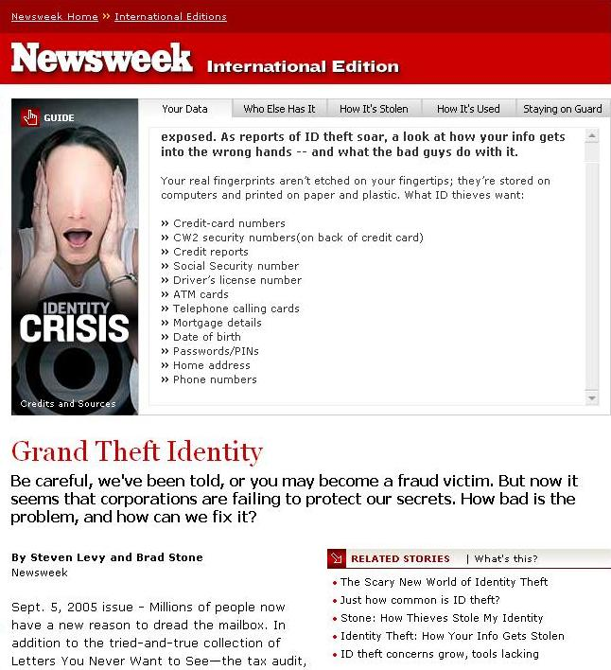
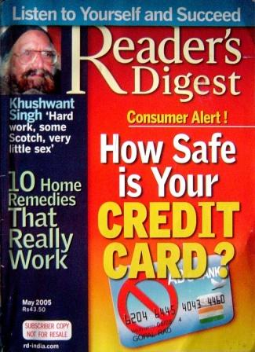
Media Stories
Consumers are bombarded with media reports narrating dangers of the online world
  Identity Theft
  Embezzlement and fraud
  Credit card
  theft
  Corporate
  Loss
Just “fear
mongering”?
So we Thought

Slide 5
Security? What is that?
Lock the doors and windows and you are secure
  NOT
Call the police when you feel insecure
  Really?
Computers are powerful, programmable machines
  Whoever programs them controls them (and not you)
Networks are ubiquitous
  Carries genuine as well as malicious traffic
End result: Complete computer security is unattainable, it is a cat and mouse game
  Similar to crime vs. law enforcement

Slide 6
Goals of Computer Security
Integrity:
  Guarantee that the data is what we expect
Confidentiality
  The information must just be accessible to the authorized people
Availability
  To make sure that the Data, Network Resources or Network Services are continuously available to the legitimate users, whenever they require it
Nonrepudiation
  The assurance that someone cannot deny the validity of something
Reliability
  Computers should work without having unexpected problems
Authentication
  Guarantee that only authorized persons can access to the resources
And More…

Slide 7
Security Basics
What does it mean to be secure?
  “Include protection of information from theft or corruption, or the preservation of availability, as defined in the security policy.” - The Wikipedia
Types of Security
  Network Security
  System and software security
  Physical Security
Very little in computing is inherently secure, you must protect yourself!
  Software cannot protect software (maybe hardware can)
  Networks can be protected better than software

Slide 8
Some Types of Attacks
What are some common attacks?
  Network Attacks
    Packet sniffing, man-in-the-middle, DNS hacking
  Web attacks
    Phishing, SQL Injection, Cross Site Scripting
  OS, applications and software attacks
    Virus, Trojan, Worms, Rootkits, Buffer Overflow
  Social Engineering
    (NOT social networking)
Not all hackers are evil wrongdoers trying to steal your info
  Ethical Hackers, Consultants, Penetration testers, Researchers

Slide 9
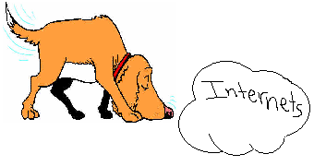
Network Attacks
Packet Sniffing
  Internet traffic consists of data “packets”, and these can be “sniffed”
  Leads to other attacks such as
  password sniffing, cookie
  stealing session hijacking,
  information stealing
Man in the Middle
  Insert a rogue router in the path between client and server, and change the packets as they pass through
DNS hijacking
  Insert malicious routes into DNS tables to send traffic for genuine sites to malicious sites

Slide 10
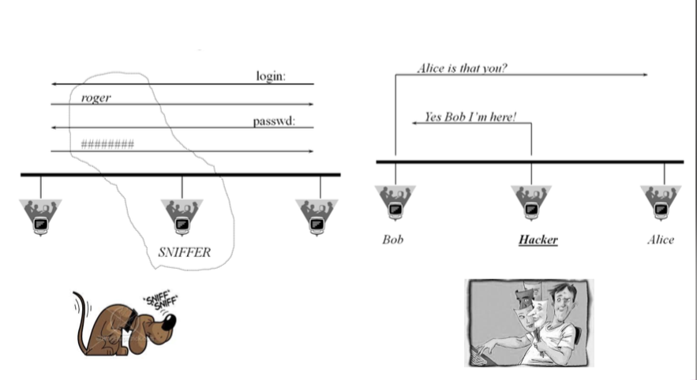

Slide 11
Web Attacks
Phishing
  An evil website pretends to be a trusted website
  Example:
    You type, by mistake, “mibank.com” instead of “mybank.com”
    mibank.com designs the site to look like mybank.com so the user types in their info as usual
    BAD! Now an evil person has your info!
SQL Injection
  Interesting Video showing an example
Cross Site Scripting
  Writing a complex Javascript program that steals data left by other sites that you have visited in same browsing session

Slide 12

Virus
Definition
  Piece of code that automatically reproduces itself. It’s attached to other programs or files, but requires user intervention to propagate.
Infection (targets/carriers)
  Executable files
  Boot sectors
  Documents (macros), scripts (web pages), etc.
Propagation
  is made by the user. The mechanisms are storage elements, mails, downloaded files or shared folders
Infection
Propagation
Payload

Slide 13
Worm
Infection
Definition
  Piece of code that automatically reproduces itself over the network. It doesn’t need user intervention to propagate (autonomous).
Infection
  Via buffer overflow, file sharing, configuration errors and other vulnerabilities.
Target selection algorithm
  Email addresses, DNS, IP, network neighborhood
Payload
  Malicious programs
  Backdoor, DDoS agent, etc.
Propagation
engine
Target
Selection
algorithm
Scanning
engine
Payload

Slide 14

Backdoor, trojan, rootkits
Goal
  The goal of backdoor, Trojan and rootkits is to take possession of a machine subsequently through an infection made via a backdoor.
Backdoor
  A backdoor is a program placed by a black-hacker that allows him to access a system. A backdoor have many functionalities such as keyboard-sniffer, display spying, etc.
Trojan
  A Trojan is a software that seems useful or benign, but is actually hiding a malicious functionality.
Rootkits (the ultimate virus)
  Rootkits operate like backdoor and Trojan, but also modify existing programs in the operating system. That allows a black-hacker to control the system without being detected. A rootkit can be in user-mode or in kernel-mode.

Slide 15
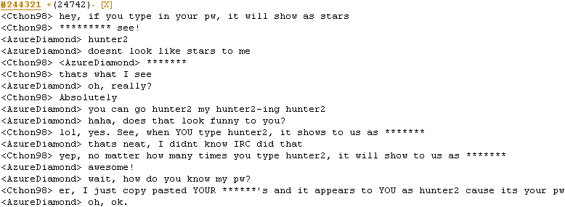
Social Engineering
*http://bash.org/?244321

Slide 16
Social Engineering
Why is this social engineering?
  Manipulating a person or persons into divulging confidential information
I am not dumb, so does this really apply to me?
  YES! Attackers are ALSO not dumb.
  Social Engineers are coming up with much better and much more elaborate schemes to attack users.
  Even corporate executives can be tricked into revealing VERY secret info
What can I do to protect myself?
  NEVER give out your password to ANYBODY.
  Any system administrator should have the ability to change your password without having to know an old password

Slide 17
Password Attacks
Password Guessing
  Ineffective except in targeted cases
Dictionary Attacks
  Password are stored in computers as hashes, and these hashes can sometimes get exposed
  Check all known words with the stored hashes
Rainbow Tables
  Trade off storage and computation – uses a large number of pre-computed hashes without having a dictionary
  Innovative algorithm, that can find passwords fast!
    e.g. 14 character alphanumeric passwords are found in about 4-10 minutes of computing using a 1GB rainbow table
Need to know:
Data structures, algorithms, cryptography

Slide 18
Computer Security Issues
Vulnerability is a point where a system is susceptible to attack.
A threat is a possible danger to the system. The danger might be a person (a system cracker or a spy), a thing (a faulty piece of equipment), or an event (a fire or a flood) that might exploit a vulnerability of the system.
Countermeasures are techniques for protecting your system

Slide 19
Vulnerabilities in Systems
How do viruses, rootkits enter a system?
  Even without the user doing something “stupid”
There are vulnerabilities in most software systems.
  Buffer Overflow is the most dangerous and common one
How does it work?
  All programs run from memory.
  Some programs allow access to reserved memory locations when given incorrect input.
  Hackers find out where to place incorrect input and take control.
  Easy to abuse by hackers, allows a hacker complete access to all resources
Need to know:
Assembly and machine level programming

Slide 20
How can you achieve security?
Many techniques exist for ensuring computer and network security
  Cryptography
  Secure networks
  Antivirus software
  Firewalls
In addition, users have to practice “safe computing”
  Not downloading from unsafe websites
  Not opening attachments
  Not trusting what you see on websites
  Avoiding Scams

Slide 21
Cryptography
Simply – secret codes
Encryption
  Converting data to unreadable codes to prevent anyone form accessing this information
  Need a “key” to find the original data – keys take a few million-trillion years to guess
Public keys
  An ingenious system of proving you know your password without disclosing your password. Also used for digital signatures
  Used heavily in SSL connections
Hashing
  Creating fingerprints of documents
Need to know:
Mathematics, number theory, cryptographic protocols

Slide 22
Why Care?
Online banking, trading, purchasing may be insecure
  Credit card and identity theft
Personal files could be corrupted
  All school work, music, videos, etc. may be lost
Computer may become too slow to run
  If you aren't part of the solution you are part of the problem
Pwn2Own contest - 2008
  Mac (Leopard) fell first via Safari, Vista took time but was hacked via Flash Player, Ubuntu stood ground.
Upon discovery, vulnerabilities can be used against many computers connected to the internet.

Slide 23
